Slide 1
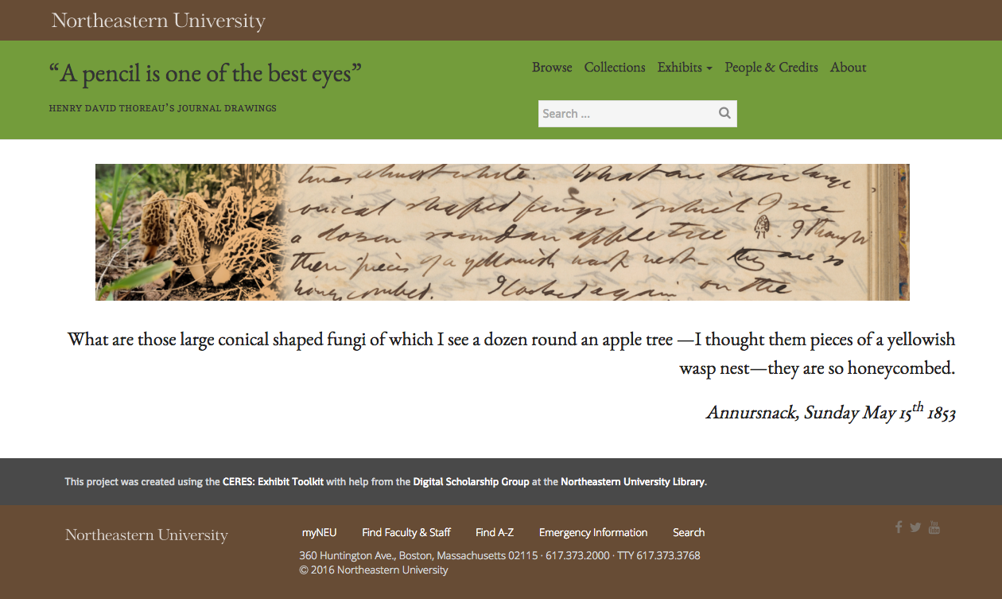
The DRS Project Toolkit
Sarah Sweeney
Eli Zoller
Digital Scholarship Group
Notes:
What we're going to do: We're going to give an update on a few DSG projects building websites using DRS content. I'm going to talk about the projects themselves, then Eli's going to walk us through some of our newer features.

Slide 2
CERES: Exhibit Toolkit
Sarah Sweeney
Eli Zoller
Digital Scholarship Group
Notes:
Name change: Now CERES exhibit toolkit, still call it "The Toolkit"
What is CERES?: One name to describe all the pieces of the repository infrastructure that supports digital scholarship and engagement with repository content

Slide 3
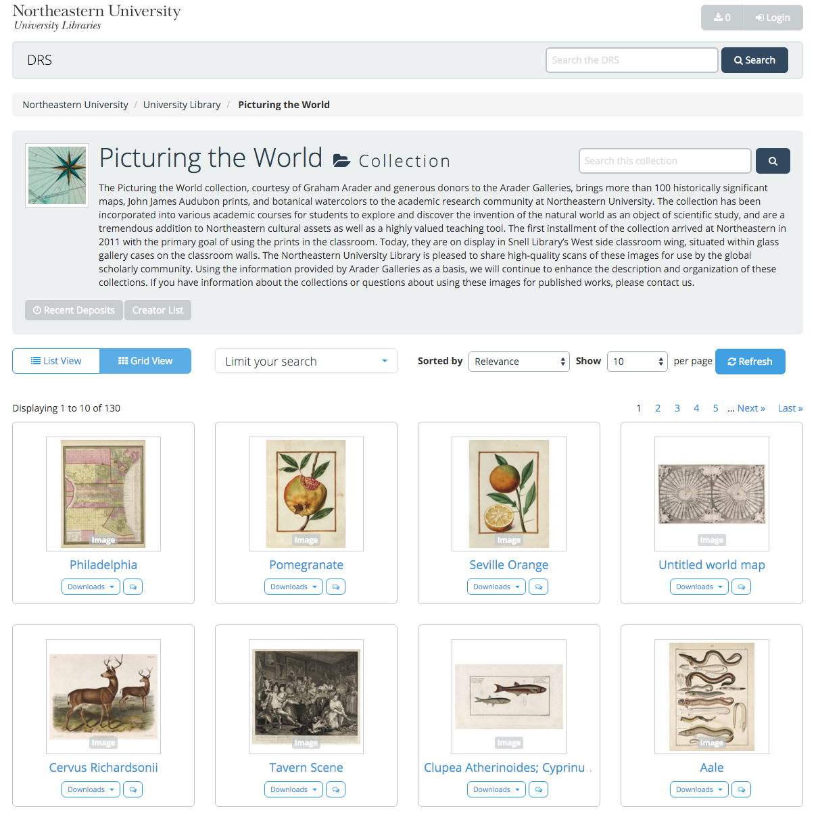
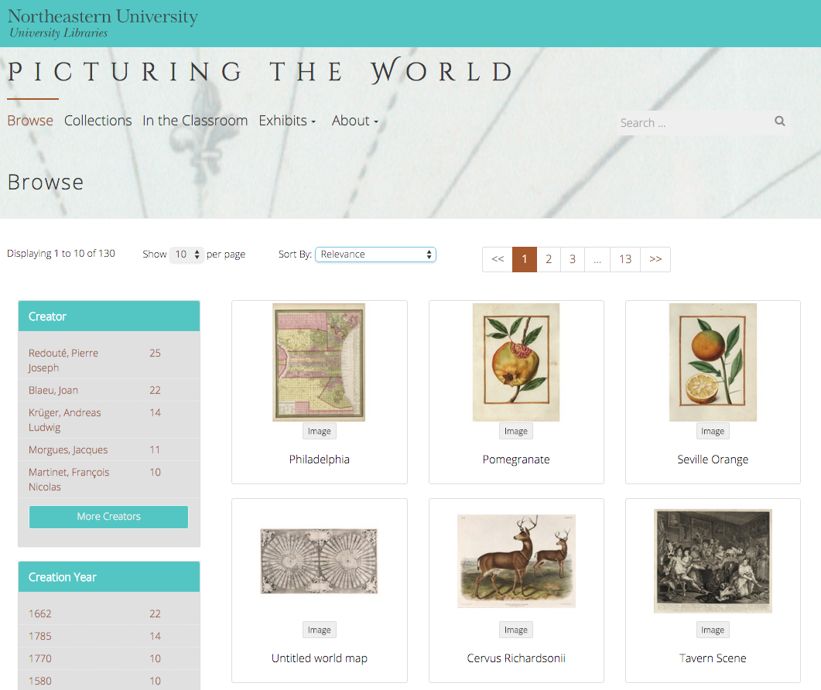
Digital Repository Service
Picturing The World
https://repository.library.northeastern.edu
http://arader.library.northeastern.edu
Notes:
What is the Toolkit?: A way to enable projects to store materials in the DRS and customize how people interact. The example you see here is the Arader Picturing the World gallery, displayed in the DRS on the left and the Toolkit site displaying those materials on the right. In addition to creating just a new interface, project teams can build various exhibits, like maps, timelines, and galleries to display those materials in more interesting ways than the DRS can on its own.
Call for Proposals: For the last two years we've put out a call for proposals in late winter to solicit new projects interested in building a site for their digital materials. This process allows us to reach out to projects and groups who we may not typically interact with, and it also allows us to solicit new tool ideas. When reviewing projects who've submitted a CFP, we tend to select them based on whether or not their project would generate new tools or allow us to enhance existing tools.

Slide 4
Toolkit Projects
http://dsg.neu.edu/projects
2016 Projects
African American Institute Archive
Dragon Prayer Book
Civil Rights and Restorative Justice Project
Early Black Boston Digital Almanac
Early Caribbean Digital Archive
Henry David Thoreau Journal Drawings
Spectrum Literary Magazine Archive
2015 Projects
In Development
Holocaust Awareness Week Programming
DMC Studios Student Work Showcase
Live
The Catskills Institute
Interviews with Jewish Latin American Writers and Artists
Picturing the World Gallery
A Proud Past: A History of Boston-Bouvé College, 1913-1981
Notes:
New projects in 2016
African American Institute Archives
Digital archive of thousands of digitized photographs.
Interested in crowdsourcing information
Dragon Prayer Book
Erika Boeckeler, Department of English
Provide research access to the manuscript
Civil Rights and Restorative Justice Project
NULawLab, School of Law
Wants to build an archive to help store and preserve materials collected during restorative justice investigations
Early Black Boston Digital Almanac
Nicole Aljoe, Department of English
Wants to students enrolled in her Writing Black Boston class to build an archive of Early African American life in Boston and New England using existing digital materials from the DRS and the DPLA
Early Caribbean Digital Archive
Continue building their archive of digitized pre-twentieth century print materials in a more sustainable system architecture that what they've used in the past
Henry David Thoreau Journal Drawings
Kathleen Kelley, Department of English
Wants to create an archive of drawings from Thoreau's journals
Spectrum Literary Magazine Archive
Spectrum Editor
Interested in building a sustainable archive of Spectrum issues, as well as an archive of the individual works contained within each issue
Previous projects: 4 out of the 6 have been launched.
Others: These are only the projects generated by the call for proposals. There are also 5 additional sites, primarily archives sites, which we issued because they didn't require any additional technical development to produce.
-------------
The Work
Responsibility:
Primarily responsible for customizing the site: the project team who submitted the request
DSG staff provide basic support for the project and the site, including guidance on best practices for building a website, training on the toolkit itself,
During the project setup and DRS deposit phases for each project, there's a lot of opportunity for library departments to contribute to these projects
Copyright and IP review
Metadata assistance
Data management
Transcoding for A/V files
Research and other guidance from liaisons

Slide 5
New Exhibit Tools in 2016
Completed
Map Exhibit
Timeline Exhibit
DPLA Integration
In Development
Enhanced image viewing (IIIF)
Notes:
Eli's going to talk about new additions to the Toolkit in 2016

